Slide 1

“AWS Cloud Cost Analyzer and Optimizer”
Presented by
Akshay Ingale [CO4032]
Abhishek Jagtap [CO4038]
Sneha Malbhage [CO4054]
Pramila Shinde [CO4072]
Under the Guidance of:
Mr. Sandesh Pawaskar
Department of Computer Engineering
KJEI,’s Trinity College of Engineering and Research, Pune
AY.: 2019 -20

Slide 2
Contents
Introduction
Objective
Motivation
Problem Statement
Idea of selected Topic
Literature Survey
Mathematical model
Existing System
Proposed System
System Architecture
Dataflow Diagram
UML Diagram
Modules
Conclusion
Future Scope
References

Slide 3
Introduction
Cloud storage service is used by many web applications to provide services to clients all over the world.
To reduce access latency, data needs to be handled by datacentres near the clients, which requires worldwide distribution of data replicas.
Thus, for a large-scale application, it is critical to have an optimal data allocation among datacentres to achieve the maximum cost saving.

Slide 4
Objective
Save cost by proposing the resource/plan reduction.
Dominant-The allocation of the data should cost based.
Efficient data Allocation And Resource Reservation.
Performance Evaluation of the services and the web applications.
Cost, Latency and efficiency enhancement.

Slide 5
Motivation
In recent studies it shows that AWS is suffering from a problem that they don’t have such record that shows which machine is using how much of computational energy and service.
It is important that the system should help to make the services and web application to more efficient and fast.

Slide 6
Problem Statement
The amazon provides the different types of services like processing power and storage capacities to meet user’s requirement’s, It is often possible that the required and allocated specifications may vary and might not be fully utilized. So a performance matrix should be used to identify the actual usage of cloud services and help user to configure the service.

Slide 7
Idea for the topic
The use of the web storage and services has been increasing rapidly, The amazon AWS is one of the leading service providers. So, performance of these services should be monitored and evaluated to verify that the resources are being properly utilized which can help in reducing the cost and tune the efficiency of the system.

Slide 8
Literature Survey
Sr . No | Paper Name | Author Name | Year | Summary
1 | Minimum-Cost Cloud Storage Service Across Multiple Cloud Providers | Guoxin Liu and Haiying Shen, Senior Member, IEEE, Member, ACM | 2018 | Service providers are suffering from less record of their customers, so trying to develop a system which is going to collect record of all system and notify to the user that they can disable the particular machine.
2 | Workload on parallel supercomputers: modeling characteristics of rigid jobs | U. Lublin and D. G. Feitelson | 2018 | While working on parallel computing the workload on computers should be maintained. The excessive imbalance could cause catastrophic failure and ineffective utilization of parallel computing.

Slide 9
Literature Survey
Sr . No | Paper Name | Author Name | Year | Summary
3 | Autonomic Metered Pricing for a Utility Computing Service | Chee Shin Yeo, Srikumar Venugopal ,Xingchen Chu. | 2017 | The fixed price on the services could not be fair to all users because not all users had the same needs. Here, users know the exact charges that are computed at the time of reservation even though they were based on variable prices.
4 | Cost-Aware Cloud Proﬁling, Prediction, and Provisioning as a Service | Ryan Chard ; Kyle Chard ; Rich Wolski ; Ravi Madduri ; Bryan Ng ; Kris Bubendorfer ; Ian Foster | 2017 | The paper present Scalable Cost-Aware Cloud Infrastructure Management and Provisioning (SCRIMP)- a service-based system that enables application developers and users to reliably outsource the task of provisioning cloud infrastructure.

Slide 10
Mathematical Model
Let S be the system: S= {U, F, R,T, Ss}, where
U= {U1, U2, U3.Un | U is a Set of all USERS} U is the users of the system.
Users of the system may grow as the system is used by more and more people. User is inﬁnite set
F=Functions
R=Evaluation Function
T=Testing
Ss = {S REG, S LOGIN, | Ss is a Set of Storage Service} STORAGE SERVER will provide four services like Registration, Login. As this set also has ﬁnite attributes, so this is also Finite Set
F1 = CPU Utilization
F2 = Storage Pricing
F3= Request Pricing

Slide 11
Cont..
ACTIVITIES AND EVENTS
EVENT 1 :
Connect to existing user’s amazon account using user id and password.
Let f(U) be a function of User Thus,
f(U)→{Ss}
EVENT 2:
User will be monitoring the critical resources.
Let f(A) be a function of System.
Thus, f(A)→{U Ss}
EVENT 3:
Evaluate need of available resources Let f(R) be a evaluation function. Thus,
f(R) →{F1,F3,F3,Fn} ε T

Slide 12
Existing System
While using cloud infrastructure users have the flexibility to choose the EC2 instance type that provides the appropriate mix of resources for the target application and workload.
Big investments are done by the companies in buying cloud infrastructure which is not used in an effective way.
The charges are applied based on the resource utilization but that is very expensive and the services provided by these systems are less not very imperative.
So there is need for the system that can help monitoring critical resources to reduce infrastructure cost from the customer’s point of view.

Slide 13
Proposed System
In proposed system we are creating private cloud (test bed) by using (Amazon Account) along with monitoring critical resources like RAM, CPU, memory, bandwidth, partition information, running process information and utilization and swap usages etc.
The system, recommends the price reduction strategy and optimum utilization of cloud resources.

Slide 14
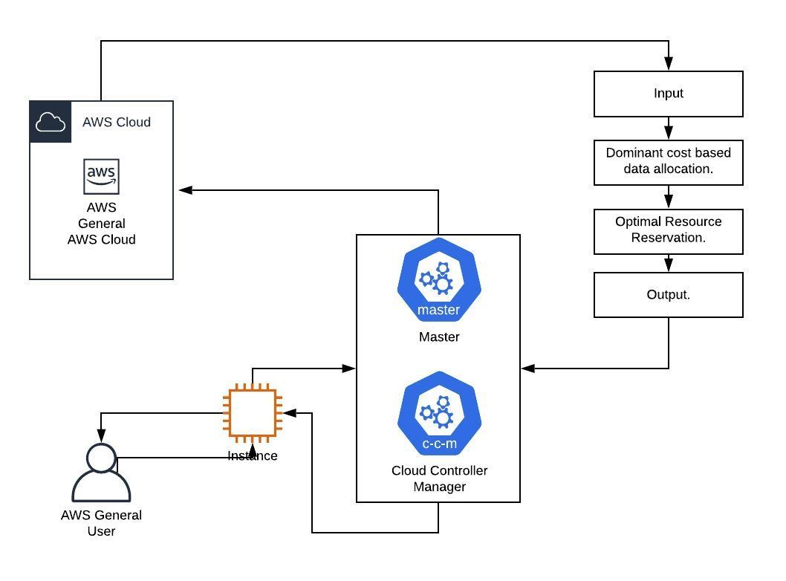
System architecture

Slide 15
Dataflow Diagram
DFD 0:
Service Provider
User
Amazon Cloud
Cloud Usage Monitoring System

Slide 16
DFD 1:
User
View Current Plane
Amazon Cloud
View VM Wise Usage
View CPU and RAM Usage Utilization
Connect to Existing User’s Amazon Account Using user Id and Password
Resource Monitoring Of Cloud Node
Cloud Usage Monitoring System

Slide 17
Storage-Pricing
Request Pricing
Storage
Management Price
CPU pricing
DFD 2:
Charge For Services
Service Provider
User
View Current Plane
Amazon Cloud
View VM Wise Usage
View CPU and RAM Usage Utilization
CPU Utilization
DiskReadBytes
DiskWriteBytes
Network IN
Network Out
Status Check
Monitor Account Wise VM usage
Connect to Existing User’s Amazon Account Using user Id and Password
Connect to Existing User’s Amazon Account Using user Id and Password
Resource Monitoring Of Cloud Node
Cloud Usage Monitoring System
Deploy Resource Monitoring and Load Balancing Tool
Evaluate Need of available Resources
Fetch all the Performance Matrix

Slide 18
UML Diagram
State Diagram:
Initial state of object
User state
Create Private cloud
Monitor Critical resources
Monitor EC2 VM Usage
View CPU and RAM Utilization
Intital state
Fetch Performance ot existing users as a performance matrix
Final state
Recommend Reduction Price
Propose efficient resources utilization

Slide 19
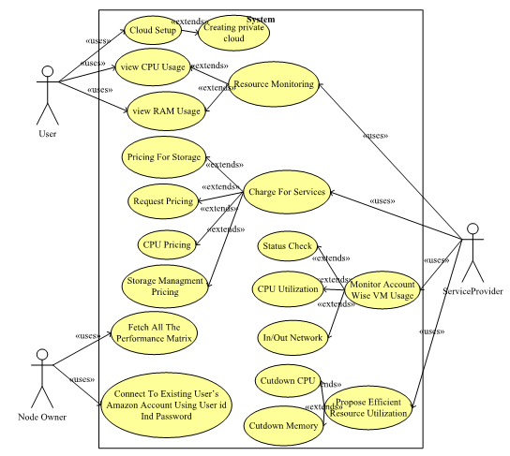
UseCase Diagram:

Slide 20
Activity Diagram:
Start
Creating Private Cloud
RAM,CPU,memory,bandwidth,partition,information,running process information
Monitoring Critical Resources
Monitor EC2 VM usage
View CPU and RAM Usage Utilization
Infrastructure which is not Being used or in an optimal use
Yes
No
Connecting exiting user’s Amazon account using User Id and Password
Fetch all the performance Matrix
Propose efficient resource utilization
Recommend Price Reduction
Stop

Slide 21
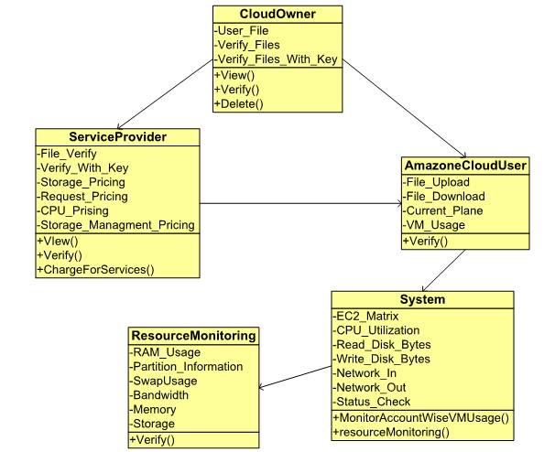
Class Diagram:

Slide 22
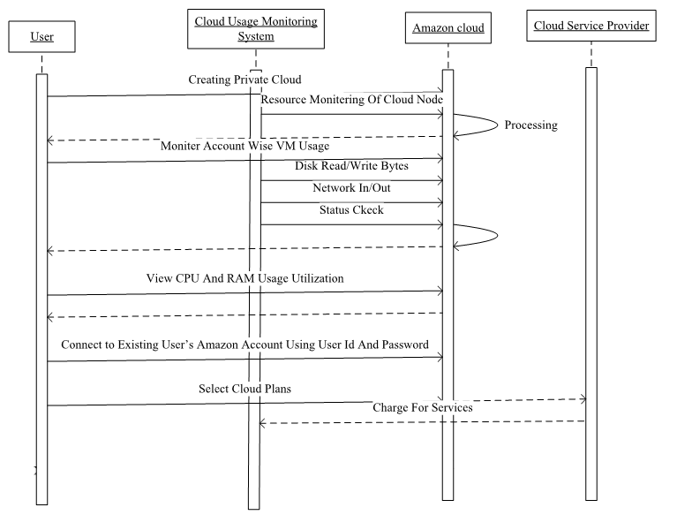
Sequence Diagram:

Slide 23
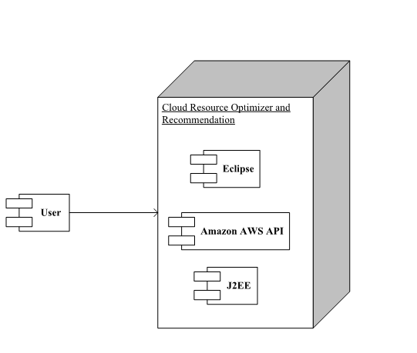
Deployment Diagram:

Slide 24
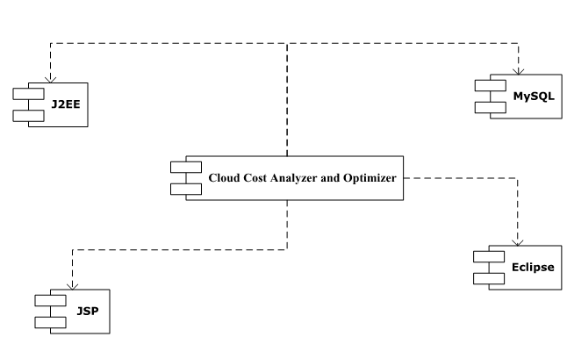
Component Diagram:

Slide 25
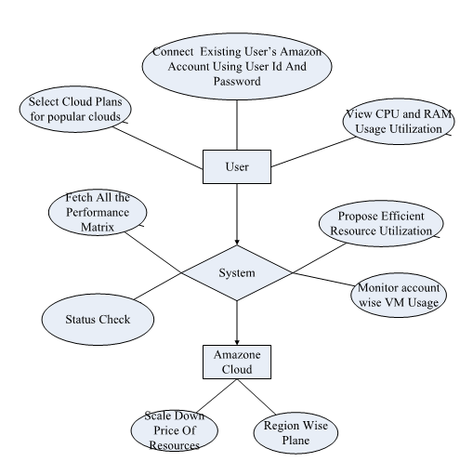
E-R Diagram:

Slide 26
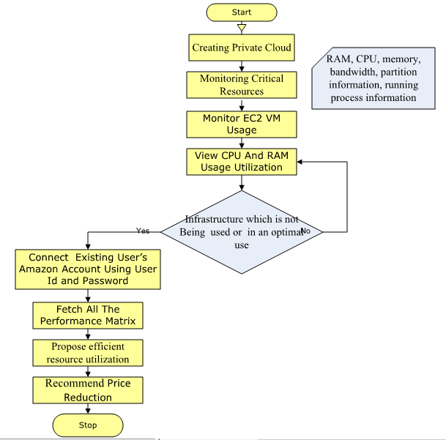
WorkFlow Diagram:

Slide 27
Modules
Resource Monitoring of Cloud Nodes:
User should be able to view CPU and RAM usage utilization of amazon ec2 nodes.
CPU and RAM utilization statistics should be dynamic and should refresh every second.
Select Cloud Plans for popular clouds like amazon: Cost of service depends on region of server, memory usage, CPU etc. Cloud service providers charge for following services which need to be added in system
Storage – Pricing
Request Pricing
Storage Management Price
CPU pricing

Slide 28
Continued..
Monitor account wise VM Usage of following parameters
1. CPU Utilization
2. Disk Read Bytes
3. Disk Write Bytes
4. Network In
5. Network Out
6. Status Check
Propose efficient resource utilization
1. By suggesting memory cut down
2. By suggesting CPU cut down
3. By suggesting storage cut down

Slide 29
Conclusion
Proposed system aims to identify the utilization of the user’s instances (Services being used), based on various parameters, eventually resulting optimal solution to the computational and storage services provided by the Amazon web services. This can be a deciding factor for cost minimizing by analyzing usage of EC2 and EBS.
The generated data can be used to identify the current usage and to predict the upcoming requirements of an organization or any individual to configure the service plan.

Slide 30
Future Scope
Scalability of application in case of increase in business need
Minimize and Optimize the payment cost of customers.
Coefficient based data reallocation
Request Redirection based congestion control.

Slide 31
References
1] Amazon Inc., “Amazon Elastic Compute Cloud (Amazon EC2),”Dec 2008, [Online] Available: http://aws.amazon.com/ec2/.
[2] GoGrid, “GoGrid cloud-server hosting,” Dec 2008, [Online]Available:
http://www.gogrid.com.
[3] A. Iosup, O. O. Sonmez, S. Anoep, and D. H. J. Epema, “The performance of bags-of-tasks in large-scale distributed systems,”in HPDC. ACM, 2008, pp. 97–108.
[4] I. Raicu, Z. Zhang, M. Wilde, I. T. Foster, P. H. Beckman, K. Iskra, and B. Clifford, “Toward loosely coupled programming on petascalesystems,” in SC. ACM, 2008, p. 22.

Slide 32
[5] A. Iosup, C. Dumitrescu, D. H. J. Epema, H. Li, and L. Wolters, “How are real grids used? The analysis of four grid traces and its implications,” in GRID.IEEE,2006,pp.262–269
[6] U. Lublin and D. G. Feitelson, “Workload on parallel supercomputers: modeling characteristics of rigid jobs,” J.Par.&Distr.Comp., vol. 63, no. 11, pp. 1105–1122, 2003.
[7] D. G. Feitelson, L. Rudolph, U. Schwiegelshohn, K. C. Sevcik, and P. Wong, “Theory and practice in parallel job scheduling, "in JSSPP,ser.LNCS,vol.1291. Springer-Verlag,1997,pp.1–34
[8] L. Youseff, R. Wolski, B. C. Gorda, and C. Krintz, “Paravirtualization for HPC systems,” in ISPA Workshops,ser.LNCS,vol.4331. Springer-Verlag, 2006, pp. 474–486.

Slide 33
Questions?

Slide 34
Thank You..!!

